Slide 1

Chapter 3
Data and Signals
3.<number>
Copyright © The McGraw-Hill Companies, Inc. Permission required for reproduction or display.

Slide 2
3-4 TRANSMISSION IMPAIRMENT
Signals travel through transmission media, which are not perfect. The imperfection causes signal impairment. This means that the signal at the beginning of the medium is not the same as the signal at the end of the medium. What is sent is not what is received. Three causes of impairment are attenuation, distortion, and noise.
Topics discussed in this section:
Attenuation
Distortion
Noise
3.<number>

Slide 3

Figure 3.25 Causes of impairment
3.<number>

Slide 4
Attenuation
Means loss of energy -> weaker signal
When a signal travels through a medium it loses energy overcoming the resistance of the medium
Amplifiers are used to compensate for this loss of energy by amplifying the signal.
3.<number>

Slide 5
Measurement of Attenuation
To show the loss or gain of energy the unit “decibel” is used.
dB = 10log₁₀P₂/P₁
P₁ - input signal
P₂ - output signal
3.<number>

Slide 6

Figure 3.26 Attenuation
3.<number>

Slide 7

Example 3.26
Suppose a signal travels through a transmission medium and its power is reduced to one-half. This means that P2 is (1/2)P1. In this case, the attenuation (loss of power) can be calculated as
A loss of 3 dB (–3 dB) is equivalent to losing one-half the power.
3.<number>

Slide 8


Example 3.27
A signal travels through an amplifier, and its power is increased 10 times. This means that P₂ = 10P₁ . In this case, the amplification (gain of power) can be calculated as
3.<number>

Slide 9

Example 3.28
One reason that engineers use the decibel to measure the changes in the strength of a signal is that decibel numbers can be added (or subtracted) when we are measuring several points (cascading) instead of just two. In Figure 3.27 a signal travels from point 1 to point 4. In this case, the decibel value can be calculated as
3.<number>

Slide 10

Figure 3.27 Decibels for Example 3.28
3.<number>

Slide 11

Example 3.30
The loss in a cable is usually defined in decibels per kilometer (dB/km). If the signal at the beginning of a cable with −0.3 dB/km has a power of 2 mW, what is the power of the signal at 5 km?
Solution
The loss in the cable in decibels is 5 × (−0.3) = −1.5 dB. We can calculate the power as
3.<number>

Slide 12
Distortion
Means that the signal changes its form or shape
Distortion occurs in composite signals
Each frequency component has its own propagation speed traveling through a medium.
The different components therefore arrive with different delays at the receiver.
That means that the signals have different phases at the receiver than they did at the source.
3.<number>

Slide 13

Figure 3.28 Distortion
3.<number>

Slide 14
Noise
There are different types of noise
  Thermal - random noise of electrons in the wire creates an extra signal
  Induced - from motors and appliances, devices act are transmitter antenna and medium as receiving antenna.
  Crosstalk - same as above but between two wires.
  Impulse - Spikes that result from power lines, lighning, etc.
3.<number>

Slide 15

Figure 3.29 Noise
3.<number>

Slide 16
Signal to Noise Ratio (SNR)
To measure the quality of a system the SNR is often used. It indicates the strength of the signal wrt the noise power in the system.
It is the ratio between two powers.
It is usually given in dB and referred to as SNR_{dB.}
3.<number>

Slide 17

Example 3.31
The power of a signal is 10 mW and the power of the noise is 1 μW; what are the values of SNR and SNR_{dB} ?
Solution
The values of SNR and SNRdB can be calculated as follows:
3.<number>

Slide 18

Example 3.32
The values of SNR and SNRdB for a noiseless channel are
We can never achieve this ratio in real life; it is an ideal.
3.<number>

Slide 19

Figure 3.30 Two cases of SNR: a high SNR and a low SNR
3.<number>

Slide 20
Nyquist Theorem
Nyquist gives the upper bound for the bit rate of a transmission system by calculating the bit rate directly from the number of bits in a symbol (or signal levels) and the bandwidth of the system (assuming 2 symbols/per cycle and first harmonic).
Nyquist theorem states that for a noiseless channel:
C = 2 B log₂2^{n}
C= capacity in bps
B = bandwidth in Hz
3.<number>

Slide 21

Example 3.36
We need to send 265 kbps over a noiseless channel with a bandwidth of 20 kHz. How many signal levels do we need?
Solution
We can use the Nyquist formula as shown:
Since this result is not a power of 2, we need to either increase the number of levels or reduce the bit rate. If we have 128 levels, the bit rate is 280 kbps. If we have 64 levels, the bit rate is 240 kbps.
3.<number>

Slide 22
Shannon’s Theorem
Shannon’s theorem gives the capacity of a system in the presence of noise.
C = B log₂(1 + SNR)
3.<number>

Slide 23
Example 3.38
We can calculate the theoretical highest bit rate of a regular telephone line. A telephone line normally has a bandwidth of 3000. The signal-to-noise ratio is usually 3162. For this channel the capacity is calculated as
This means that the highest bit rate for a telephone line is 34.860 kbps. If we want to send data faster than this, we can either increase the bandwidth of the line or improve the signal-to-noise ratio.
3.<number>

Slide 24
Example 3.39
The signal-to-noise ratio is often given in decibels. Assume that SNR_{dB} = 36 and the channel bandwidth is 2 MHz. The theoretical channel capacity can be calculated as
3.<number>

Slide 25
Unipolar
All signal levels are on one side of the time axis - either above or below
NRZ - Non Return to Zero scheme is an example of this code. The signal level does not return to zero during a symbol transmission.
Scheme is prone to baseline wandering and DC components. It has no synchronization or any error detection. It is simple but costly in power consumption.
4.<number>

Slide 26
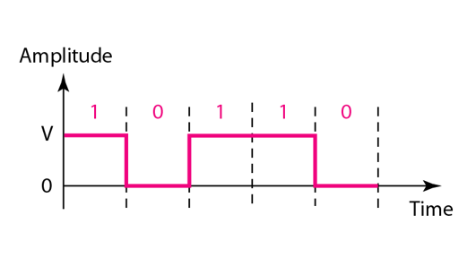
Figure 4.5 Unipolar NRZ scheme
4.<number>

Slide 27
Polar - NRZ
The voltages are on both sides of the time axis.
Polar NRZ scheme can be implemented with two voltages. E.g. +V for 1 and -V for 0.
There are two versions:
  NZR - Level (NRZ-L) - positive voltage for one symbol and negative for the other
  NRZ - Inversion (NRZ-I) - the change or lack of change in polarity determines the value of a symbol. E.g. a “1” symbol inverts the polarity a “0” does not.
4.<number>

Slide 28
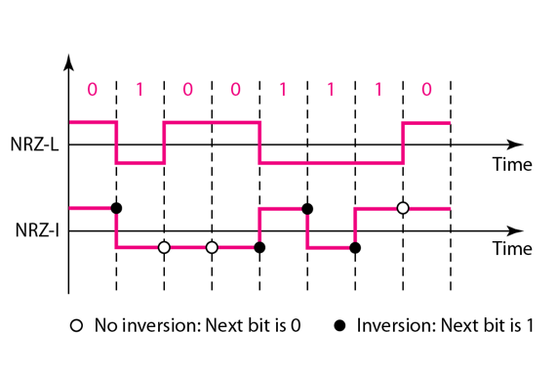
Figure 4.6 Polar NRZ-L and NRZ-I schemes
4.<number>

Slide 29
Polar - RZ
The Return to Zero (RZ) scheme uses three voltage values. +, 0, -.
Each symbol has a transition in the middle. Either from high to zero or from low to zero.
This scheme has more signal transitions (two per symbol) and therefore requires a wider bandwidth.
No DC components or baseline wandering.
Self synchronization - transition indicates symbol value.
More complex as it uses three voltage level. It has no error detection capability.
4.<number>

Slide 30
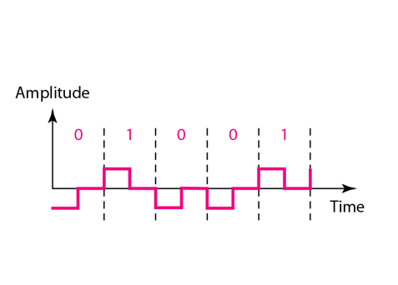
Figure 4.7 Polar RZ scheme
4.<number>

Slide 31
Polar - Biphase: Manchester and Differential Manchester
Manchester coding consists of combining the NRZ-L and RZ schemes.
  Every symbol has a level transition in the middle: from high to low or low to high. Uses only two voltage levels.
Differential Manchester coding consists of combining the NRZ-I and RZ schemes.
  Every symbol has a level transition in the middle. But the level at the beginning of the symbol is determined by the symbol value. One symbol causes a level change the other does not.
4.<number>

Slide 32
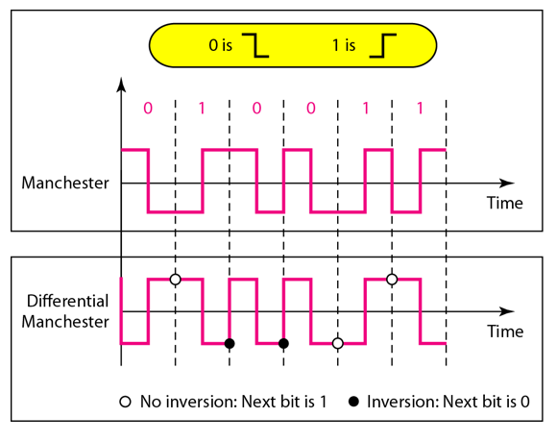
Figure 4.8 Polar biphase: Manchester and differential Manchester schemes
4.<number>

